Slide 1
DCS Overview

Slide 2
Collection Agencies
Ease account load on Business Office by outsourcing
Early out
  Self Pay Accounts
  Eligibility searching
  Copays and patient portions
Bad Debt
  Account has a balance, but no payment received with in the allotted timeframe defined by facility

Slide 3
What is DCS
A delivery service that allows the healthcare facility to send full account information to a collection agency.
An internal index of accounts is maintained.
Subsequent transactions within MEDITECH are sent to the collection agency.
The collection agency sends its work effort/activity back to MEDITECH and is posted.

Slide 4
Components of DCS
MEDITECH I/O Delivery Services
Outbound file to a collection agency
Inbound file from a collection agency
A new BAR dictionary called Debt Collection System Agency Group
Modified BAR Collection Dictionaries
New Menu Routines in BAR
BAR Application processes

Slide 5
Set Up
In BAR, the DCS dictionary is used to define each “debt collection system.”
  ACS System
  IHMS System
  CMRE System
Use this dictionary to define the Outbox recipient and the paths to which the audit reports should be printed or downloaded.

Slide 6
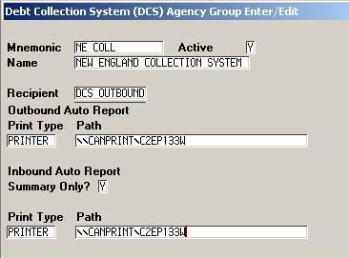
Set Up – DCS Dictionary
Agency System Mnemonic
Agency System Name
MEDITECH Delivery Service to utilize
OUTBOUND
Delivery transport method
Delivery path
INBOUND
Delivery transport method
Delivery path

Slide 7
Outbound from MEDITECH
A user compiles a file that will be sent to a specific collection agency.
  Patient demographics
  Transactions
  Comments
The file is delivered via MEDITECH Outbound DCS Delivery Service to a network location for the agency to pick up.

Slide 8
Import DCS File
The inbound file is read in and applies:
  comments to the accounts
  Processes any agency changes
  Creates a batch of payment and adjustment transactions.

Slide 9
Inbound to MEDITECH
A collection agency sends a file to CHW.
  Comments
  Payments
  Adjustments
  Secondary agency placement codes

Slide 10
Vendors that will utilize DCS
ACS/PASC
HFRI
Grant-Weber
IHMS
MCRU
CMRE
OVAG
Xtra
Triage

Slide 11
Set Up Owners
MEDITECH I/O Delivery Services | MEDITECH
Outbound File Specs | NPR Report Writer
Inbound File Specs | MEDITECH
DCS Dictionaries | BAR Team
DCS Processes | BAR Team and Revenue Cycle
DCS Reports | BAR Team and Revenue Cycle
MEDITECH BJP User Windows Permissions | Integration/TPA
Testing | BAR Team
Monitoring and Oversight | Integration/TPA

